Slide 1
2
Classical propagation
2.1 Propagation of light in a dense optical medium
2.2 The dipole oscillator model
2.3 Dispersion
2.4 Optical anisotropy: birefringence

Slide 2
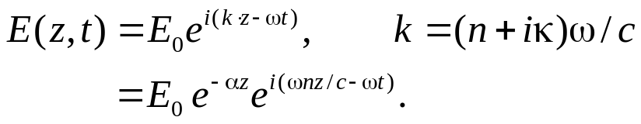
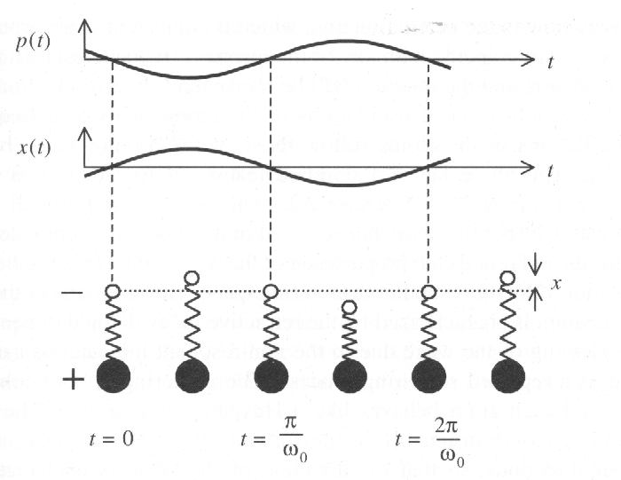
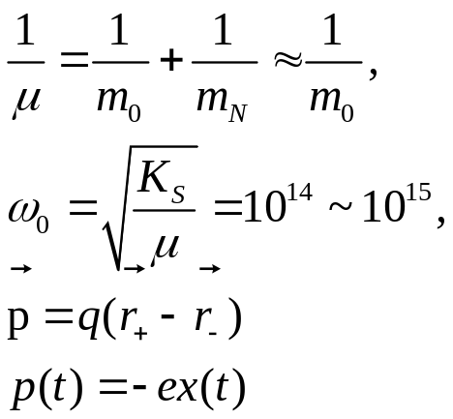
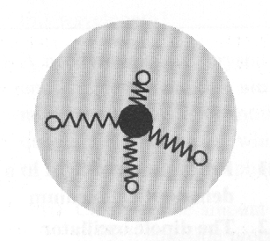
Chapter 2 Classical propagation
Model:
Light: electromagnetic wave
Atom and molecule: classical dipole oscillator
n(ω), α (ω)
写错了，不该用α，该用κ
Two propagation parameters:
n, α
2.1 Propagation of light in a dense optical medium
Three types of oscillators:
1. bound electron (atomic) oscillator
2. vibrational oscillator;
3. free electron oscillators
2.1.1 Atomic oscillators

Slide 3
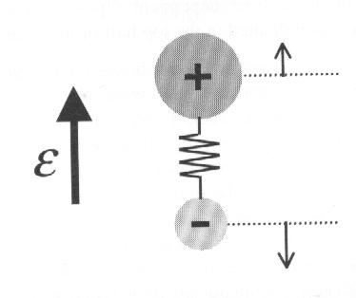
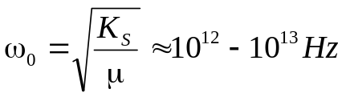
2.1 Propagation of light in a dense optical medium
2.1.1 Atomic oscillators
If ω = ω₀, resonant absorption
(Beer’s law)
h ω = E₂ - E₁
re-radiated photon – luminesce
radiationless transition
If ω ≠ ω0, non-resonant, transparent
The oscillators follow the driving wave,
but with a phase lag. The phase lag
accumulates through the medium and
retards the propagation of the wave
front, leading to smaller velocity than
in free space (v =c / n).
-- the origin of n
Coherent and Elastic
2.1.2 Vibrational oscillators
Infrared spectral region
In a crystalline solid form the condensation of polar
molecules, these oscillations are associated with
lattice vibrations (phonons).
2.1.3 Free electron oscillators
Free electrons, K_{s} = 0, ω₀ = 0
Drude-Lorentz model
Classical model of a polar molecule
(an ionic optical medium)

Slide 4
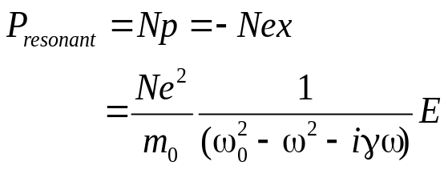
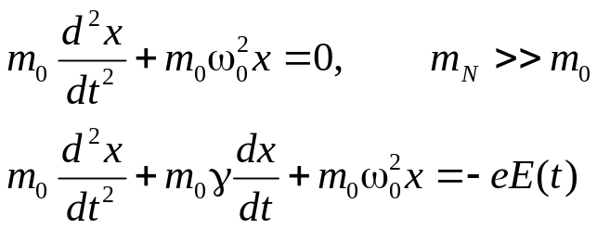
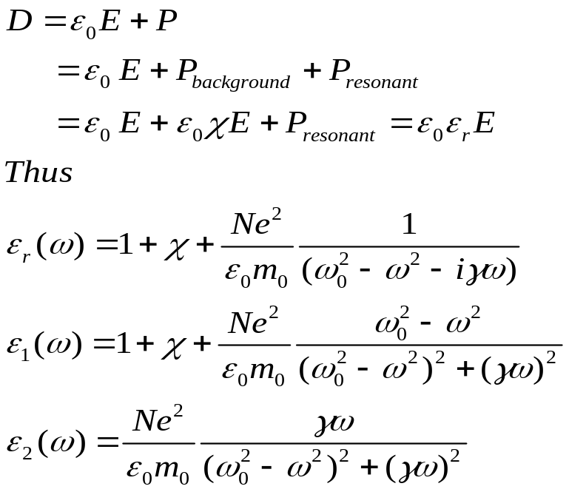
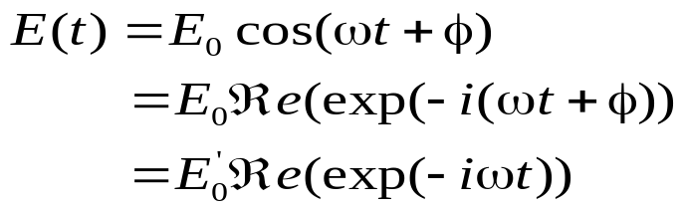
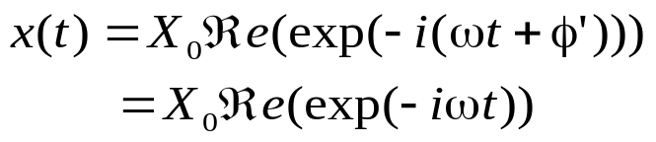
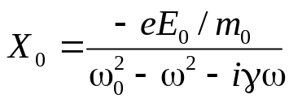
2.2 The dipole oscillator model
2.2.1 The Lorentz oscillator
Light wave will drive oscillations at its own
Frequency:
The macroscopic polarization of medium P:
The electric displacement D:
Solution;
The gives:
With:

Slide 5
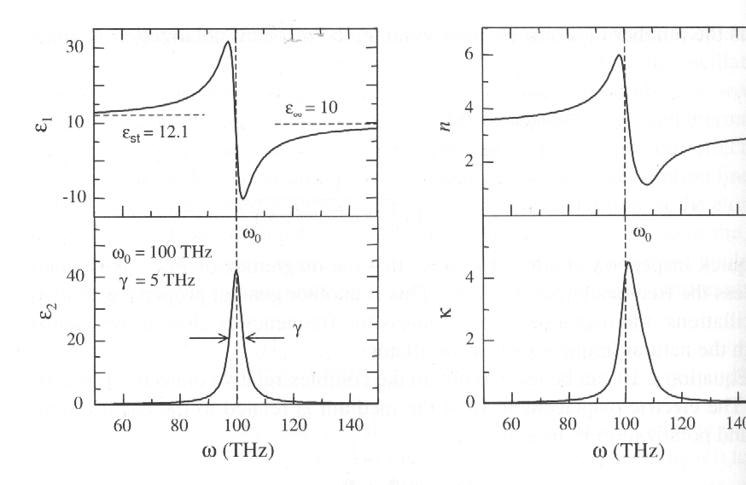
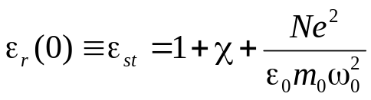

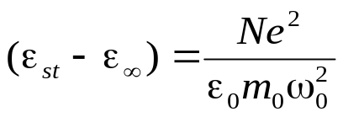
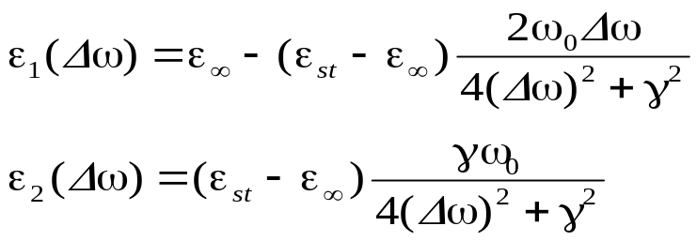
2.2 The dipole oscillator model
2.2.1 The Lorentz oscillator
low frequency limit:
high frequency:
Thus
Close to resonance:
Frequency dependence of the real and imaginary
Parts of the complex dielectric constant of a dipole
At frequencies close to resonance. Also shown is
The real and imaginary part of the refractive index
Calculated from the dielectric constant.
吸收峰位于ω_{o,} 半宽= γ;
ε₁的极值位于 ω_{o} ± γ， ε₁出现负值;
折射率在ω_{o} ± γ区间出现反常色散。

Slide 6
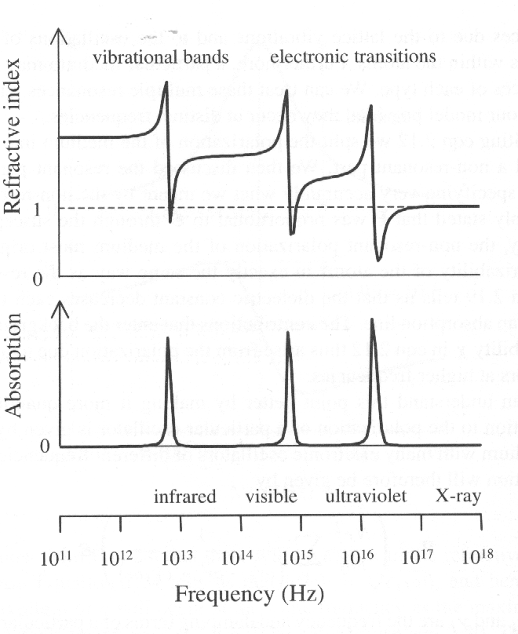
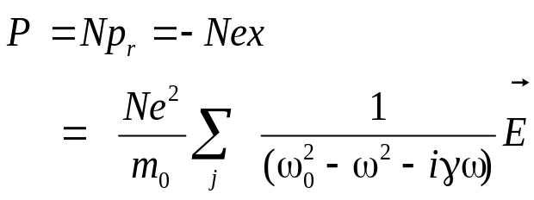
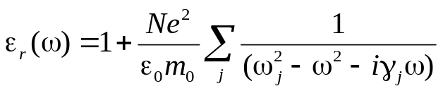
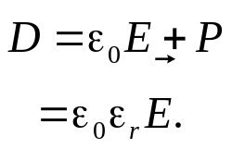
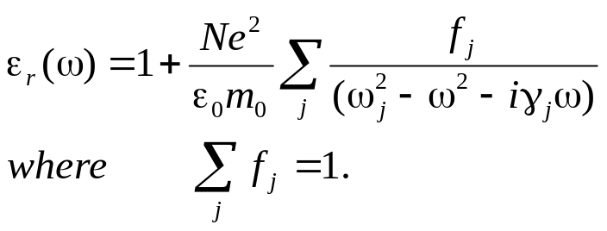
2.2 The dipole oscillator model
2.2.2 Multiple resonance
Take account of all the transitions in the medium
Assign a phenomenological oscillator strength
f_{j} to each transition:
Schematic diagram of the frequency dependence of the refractive index and absorption of a hypothetical solid from the infrared to the x-ray spectral region. The solid is assummed to have three resonant frequencies with width of each absorption line has been set to 10% of the centre frequency by appropriate choice of the γ_{j}’s.
For each atom.

Slide 7
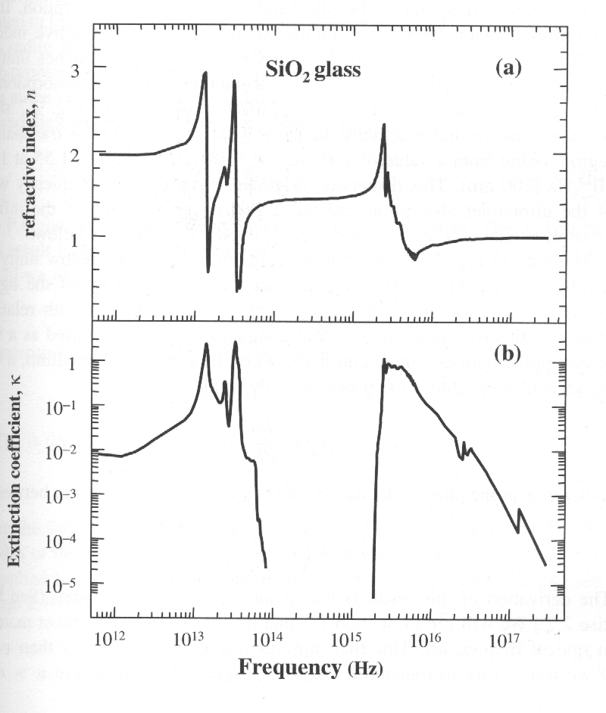
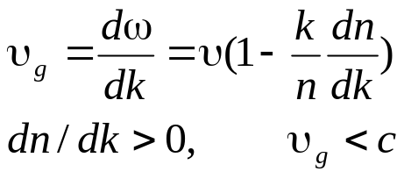
2.2 The dipole oscillator model
2.2.3 Comparison with experimental data
1. n >> κ except near the peaks of the absorption;
2. The transmission range of optical materials is
determined by the electronic absorption in UV
and the vibrational absorption in IR;
3. IR absorption is caused by the vibrational quanta
in SiO₂ molecules themselves(1.4 × 10¹³ Hz
(21μm) and 3.3 × 10¹³ Hz(9.1 μm);
4. UV absorption is caused by interband electronic
transition(band gap of about 10 eV), threshold at
2 × 10¹⁵ Hz(150 nm)(α ~ 10⁸ m⁻¹);
5. UV absorption departure from Lorentz model;
6. n actually increases with frequency in trans-
parency region, the dispersion originates from
wings of two absorption peaks of UV and IR;
7. The phase velocity of light is greater than c in
region where n falls below unity;
8. Group velocity:
Refractive index and (b) extinction co-
Efficient of fused silica (SiO₂) glass from the
Infrared to the x-ray spectral region.

Slide 8
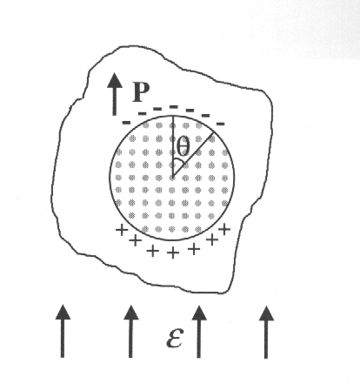
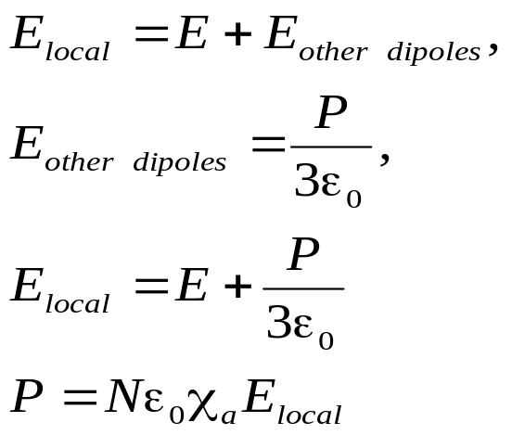
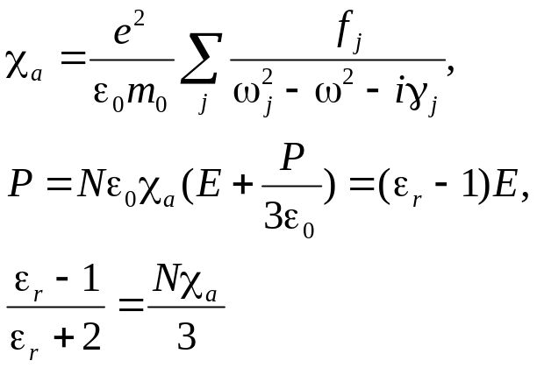
2.2 The dipole oscillator model
2.2.4 Local field correction
The actually atomic dipoles respond not
only to the external field, but also to the
field generated by all the other dipoles
Model used to calculate the local field by
the Lorentz correction. A imaginary spherical
surface drawn around a particular atom
divides the medium into nearby dipoles and
distant dipoles. The field at the centre of the
sphere due to the nearby dipoles is sunned
exactly, while the field due to the distant dipoles is calculated by treating the material outside the sphere as a uniformly polarized dielectric.
这就是张伟华的小球介电常数
Clausius-Mossotti
relationship

Slide 9
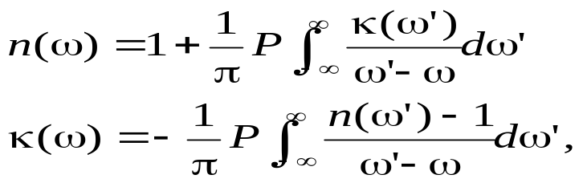
2.2 The dipole oscillator model
2.2.5 The Kramers-Kronig relationships
The discussion of the dipole oscillator shows that the refractive index and the absorption coefficient are not independent parameters but are related to each other. If we invoke the law of causality (that an effect may not precede its cause) and apply complex number analysis, we can derive general relationships between the real and imaginary parts of the refractive index as follows:
Where P indicates that the principal part of the integral should be taken. The K-K relationships allow to calculate n and κ, and vice versa.

Slide 10
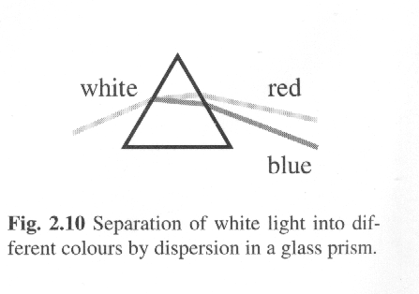
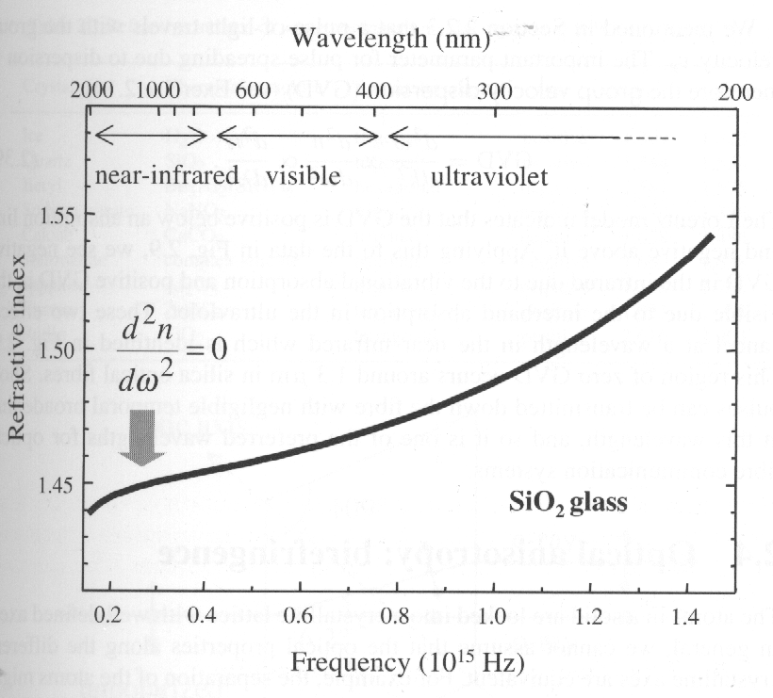
2.2 Dispersion
This dispersion mainly originates from the interband
absorption in the UV and the vibrational absorption
in IR
Normal dispersion :
the refractive index increases
with frequency;
Anomalous dispersion:
the contrary occurs.
Refractive index of SiO₂ glass in the IR, visible
And UV regions

Slide 11
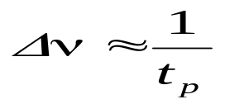
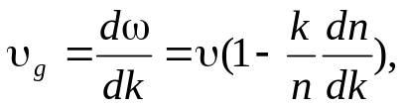
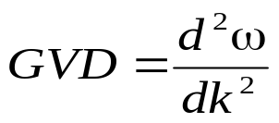
2.2 Dispersion
Pulse broadening
Dispersion causes the very short pulse to broaden
in time as it propagates through the medium.
group velocity dispersion (GVD)
The Lorentz model indicates that GVD is positive below an absorption line and negative above it. There is a region of zero GVD around 1.3 μm in silica. So short pulses can be transmitted down the silica fibre with negligible temporal broadening at this wavelength.

Slide 12
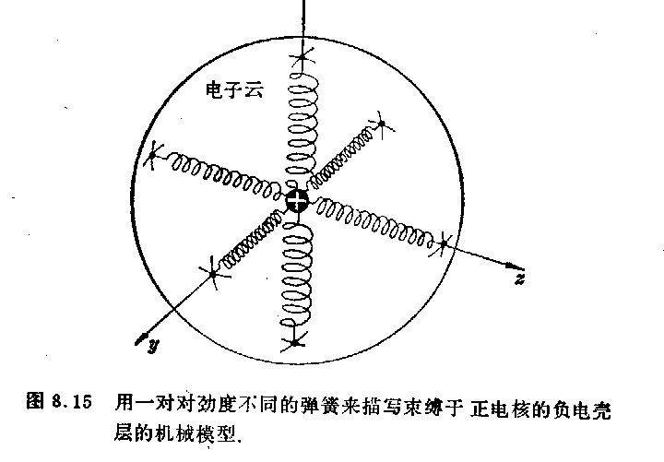
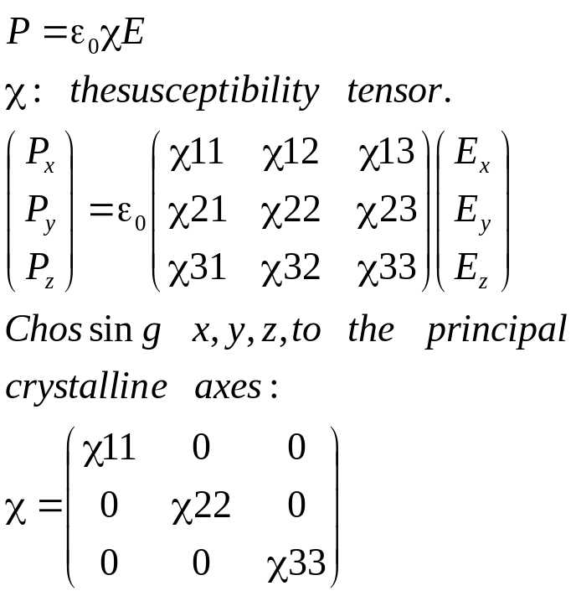
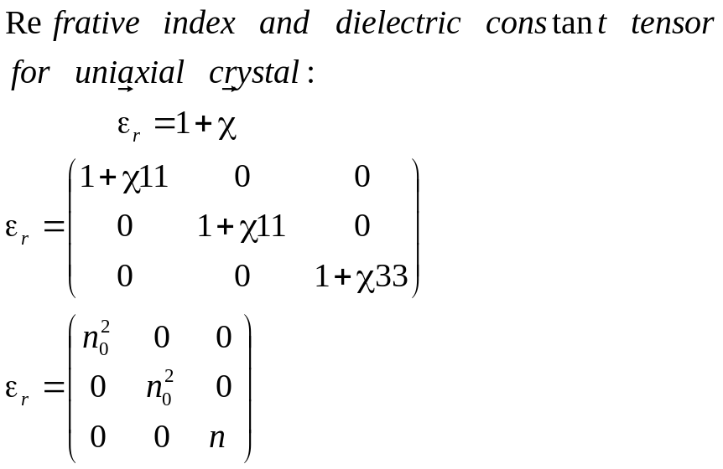
2.2 Optical anisotropy: birefringence
The relationship of the P and E
Cubic: χ11 = χ22 = χ33, isotropic;
Tetragonal, hexagonal or trigonal:
χ11 = χ22 ≠ χ33, uniaxial;
Orthorhombic, monoclinic or triclinic:
χ11 ≠ χ22 ≠ χ33, biaxial.

Slide 13
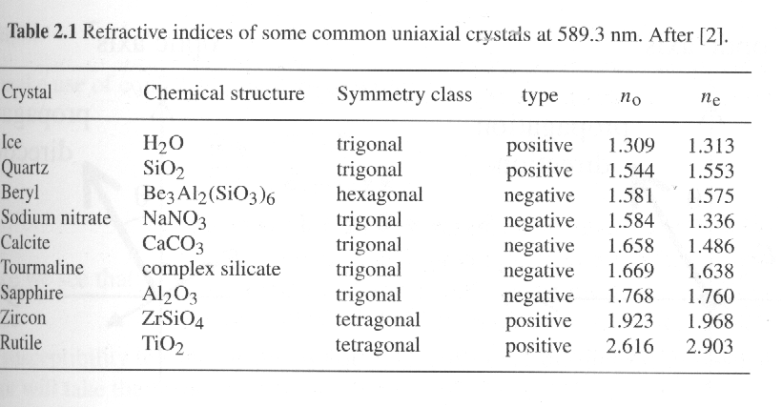
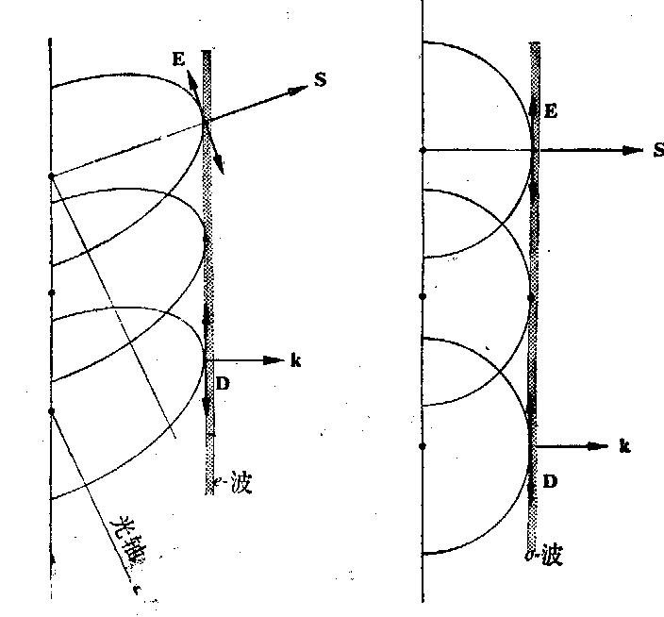
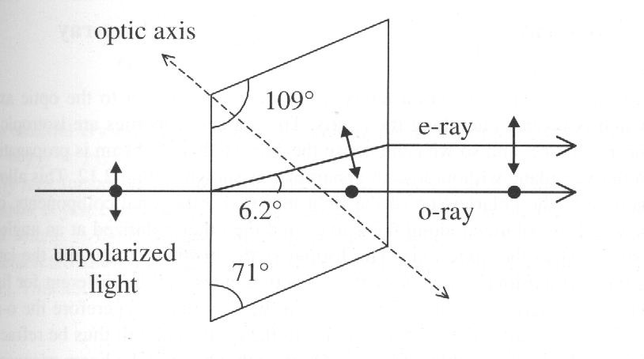
2.2 Optical anisotropy: birefringence
Double refractive in a natural calcite crystal, an un-
polarized incident light ray is split into two spatially
separated orthogonally polarized rays.

Slide 14
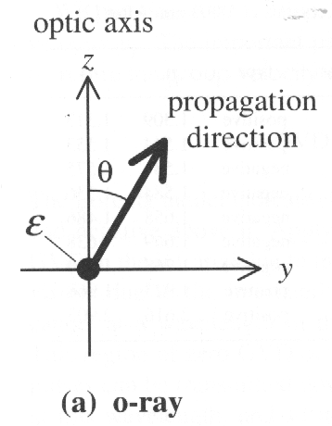
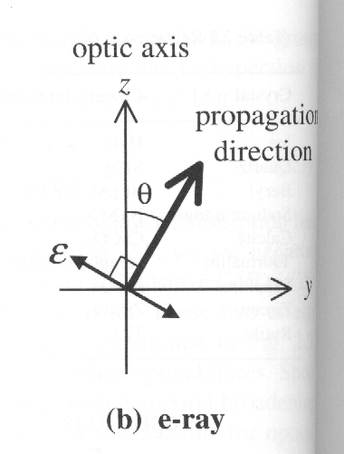
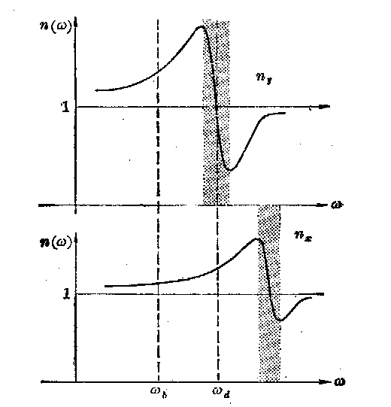
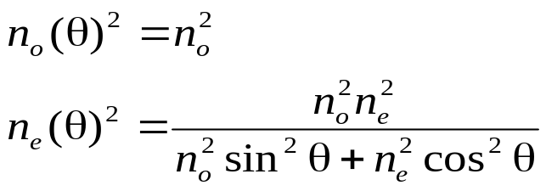
2.2 Optical anisotropy: birefringence
Electric field vector of ray propagating in a uniaxial crystal with is its optic axis along the z direction. The ray makes an angle of θ with respect to the optic axis. The polarization can be resolved into: (a) a component along the x-axis and (b) a component at an angle of 90º - ϑ to the optic axis. (a) Is o-ray and (b) is the e-ray.

Slide 15
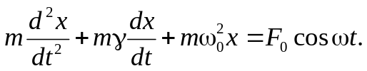
Exercises:
The full width at half maximum of the strongest hyperfine component of the sodium D₂ line at 589.0 nm is 100 MHz. A beam of light passes through a gas of sodium with an atom density of 1×10¹⁷ m⁻³. Calculate: (i) The peak absorption coefficient due to this absorption line. (ii ) The frequency at which the resonant contribution to the refractive index is at a maximum. (iii) The peak value of the resonant contribution to the refractive index.
( i); 1.7*10³m⁻¹; ii) 50 MHz below the line center; iii) 3.95 * 10⁻⁵)
2. A damped oscillator with mass, natural frequency ω₀, and damping constant γ is being driven by a force of amplitude F₀ and frequency ω. The equation of motion for the displacement x of the oscillator is:
What is the phase of x relative to the phase of the driving force?
(-tan⁻¹[ωγ/(ω₀²-ω²)])
3. Show that the absorption coefficient of a Lorentz oscilator at the line centre does not depend on the value of ω_{0.}

